Slide 1
Asha Babu
Electromyographic Correlates of Listening Effort: Differentiating Vestigial Auriculomotor Activity under High Cognitive Load
13/03/2026 HTW Saar, Germany./ Master Thesis

Slide 2
Contents
Introduction
Goal
Cochlea
Materials and Methods
Results
Discussion
Conclusion
Bibliography
1

Slide 3
Introduction
The "Neural Fossil“[1]
Why does auditory effort matter?
We must distinguish between automatic orientation (System 1) and effortful, resource-demanding listening (System 2) [11].
Does this high load "break" our auriculomotor orienting reflex, or does the brain prioritize it to protect the signal?
2

Slide 4
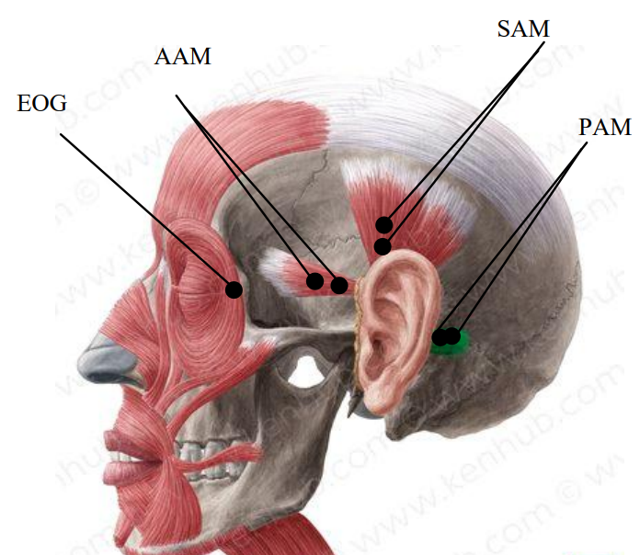
Motivation
Figure 1: Experimental setup for measuring auriculomotor activity. The black dots indicate the placement of bipolar surface electrodes over the three primary extrinsic ear muscles: the anterior (AAM), superior (SAM), and postauricular (PAM) muscles. An additional electrode placement (EOG) is positioned near the eye to track and filter out gaze-shifting artifacts [3].
3

Slide 5
Goal
The Gap: This study tests whether the PAM acts as an objective, muscle-based biomarker of listening effort.
By recording from all three extrinsic ear muscles (PAM, SAM, AAM), we isolate the functional response of the PAM from the background noise of generalized cranial muscle tension.
4

Slide 6
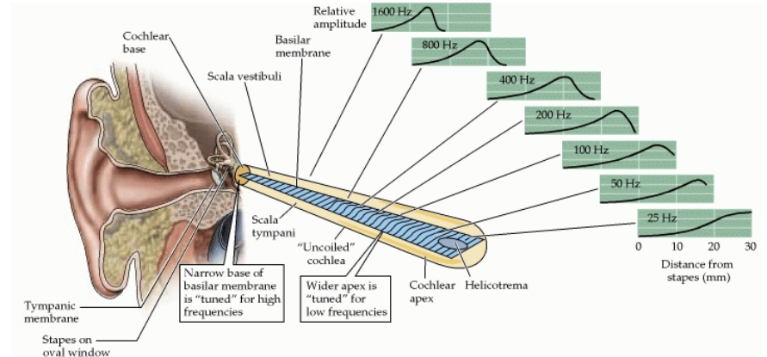
Cochlea
Figure 2: T o n o t o p i c f r e q u e n c y m a p p i n g a l o n g t h e h u m a n b a s i l a r m e m b r a n e [ 8 ] .
5

Slide 7
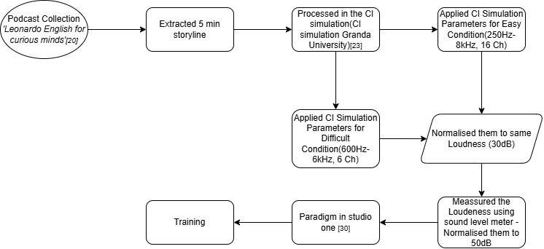
Materials and Methods
Figure 3. Block diagram of stimuli processing [31]
6

Slide 8
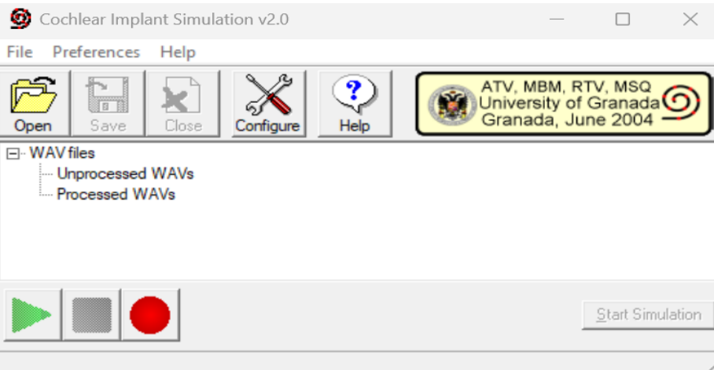
Materials and Methods
Figure 4 Cochlear Implant Simulation Software [23]
7

Slide 9
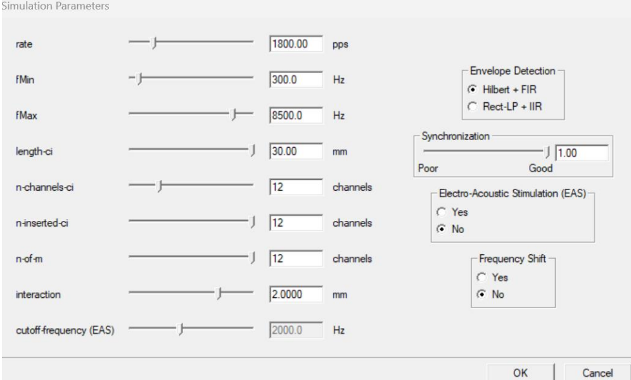
Materials and Methods
Figure 5 Cochlear Implant Simulation Parameters [23]
8

Slide 10
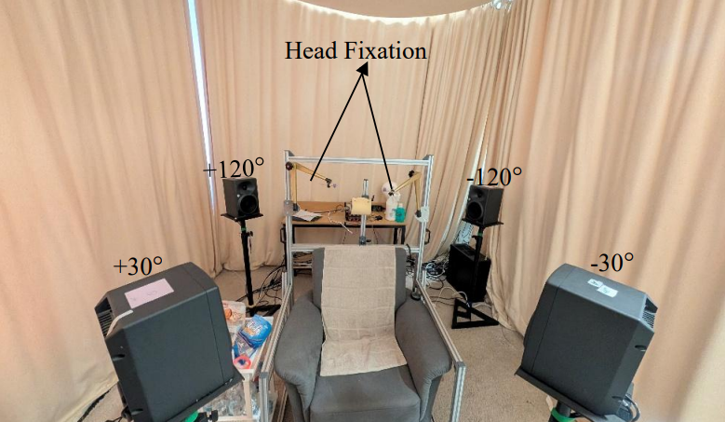
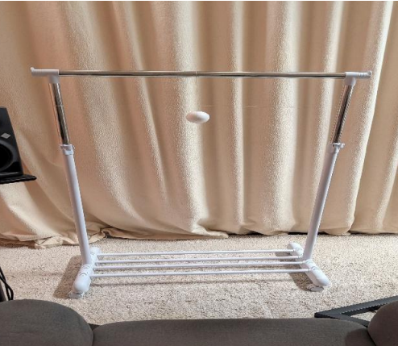
Materials and Methods
Figure 7. Experimental Setup
9

Slide 11
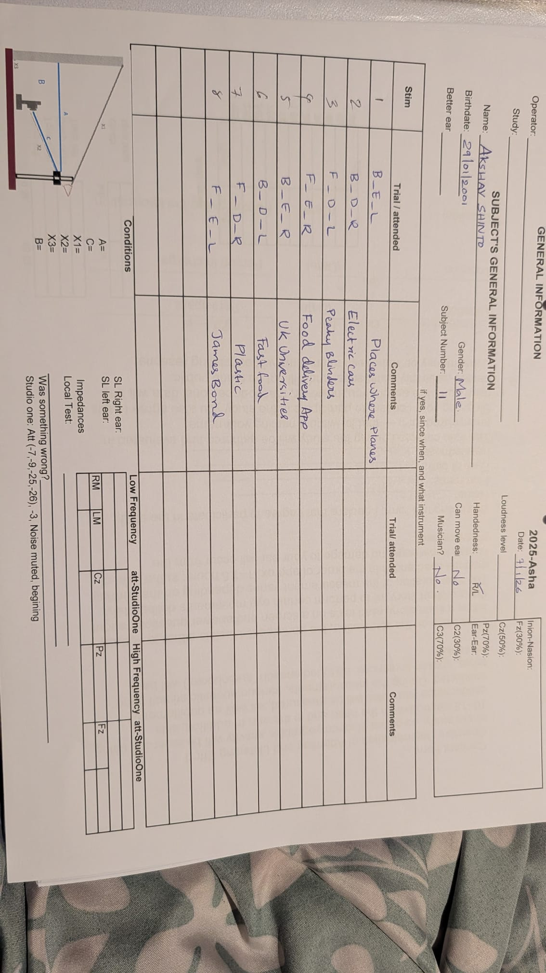
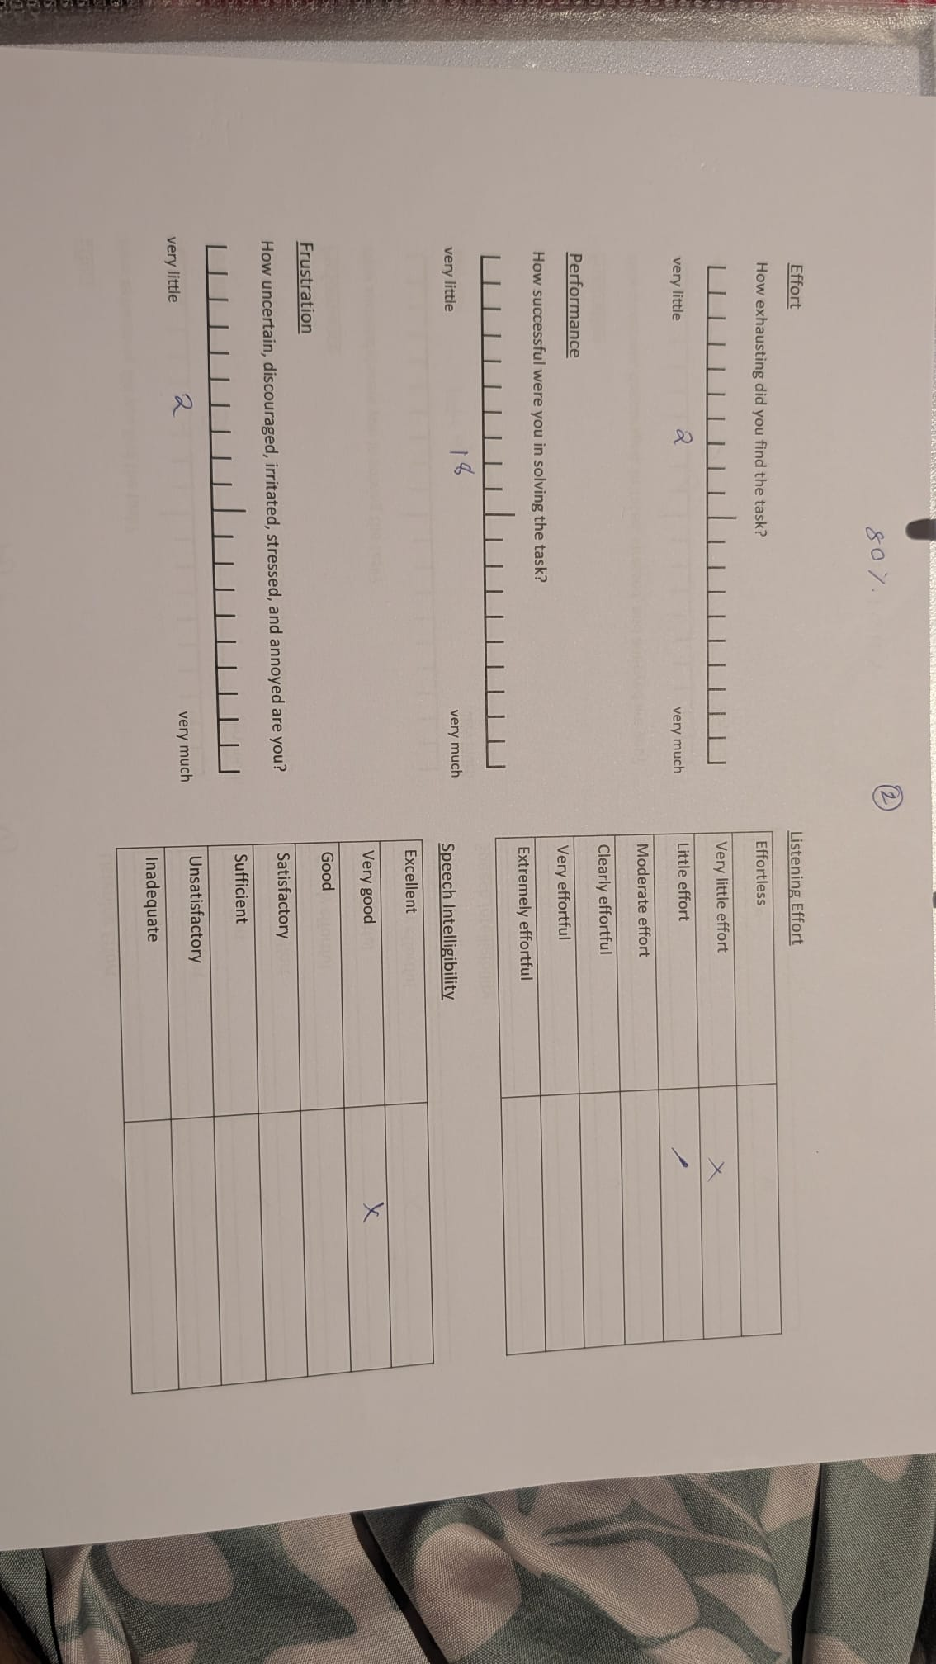
Materials and Methods
Figure 8. Data sheets of Subjective Measurements
10

Slide 12
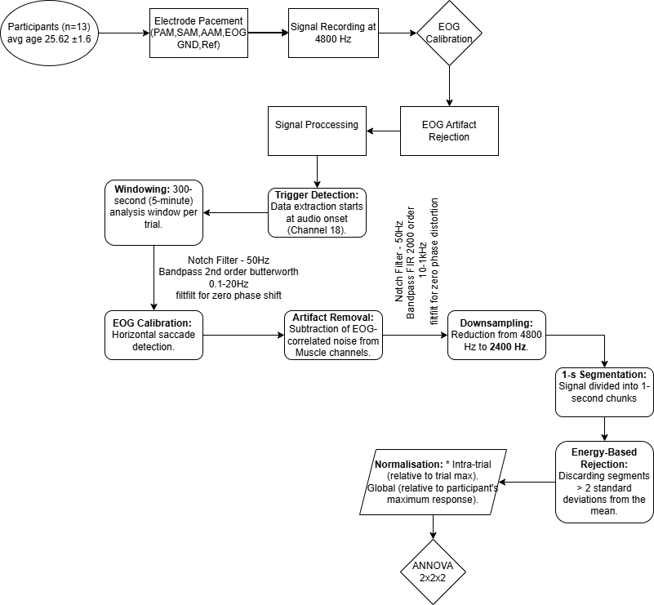
Materials and Methods
Figure 9. Block diagram of Signal processing[31]
11

Slide 13
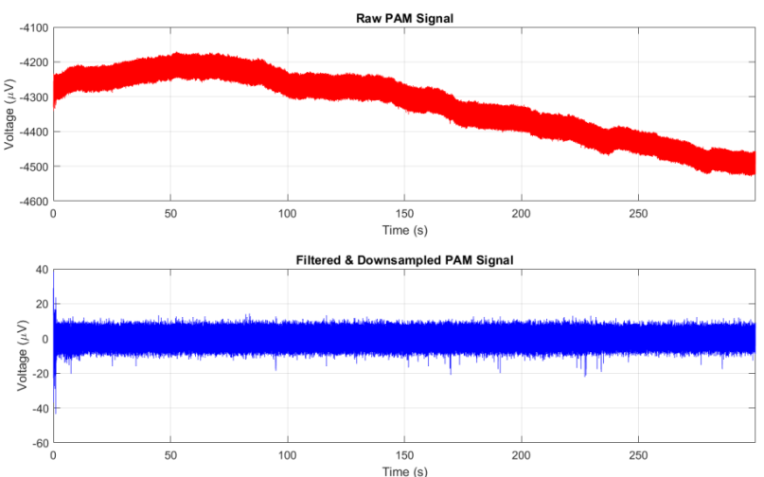
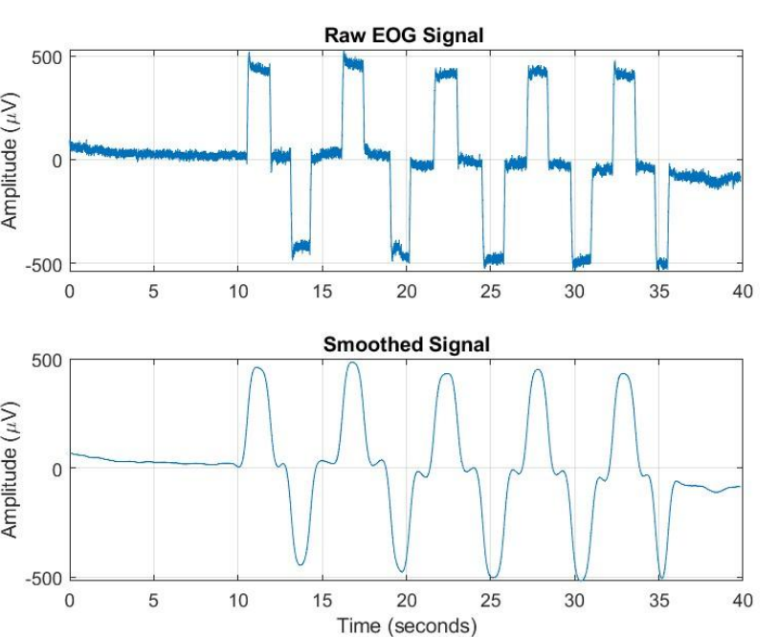
Materials and Methods
Figure 10. Filtered PAM and EOG signals[32].
12

Slide 14
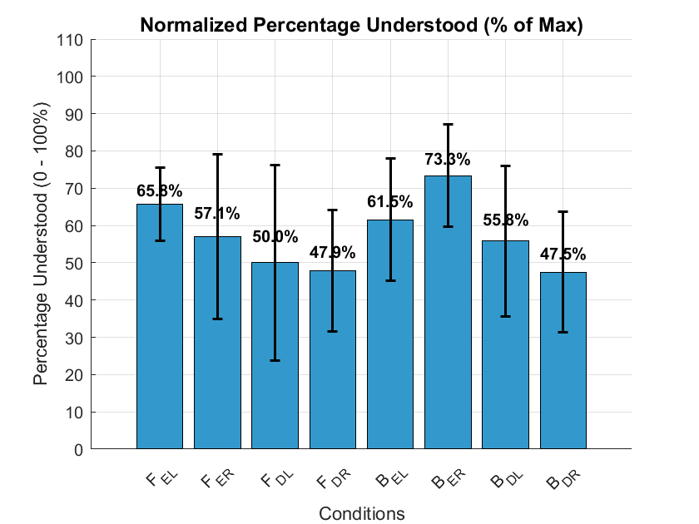
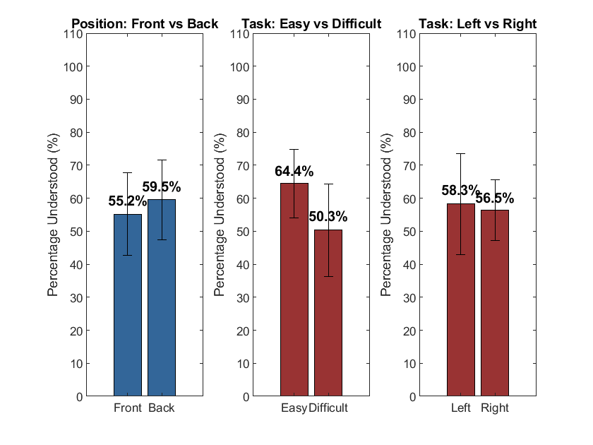
Subjective Analysis – Percentage Understood
Figure 11. Subjective Analysis of Percentage Understood[32]
13

Slide 15
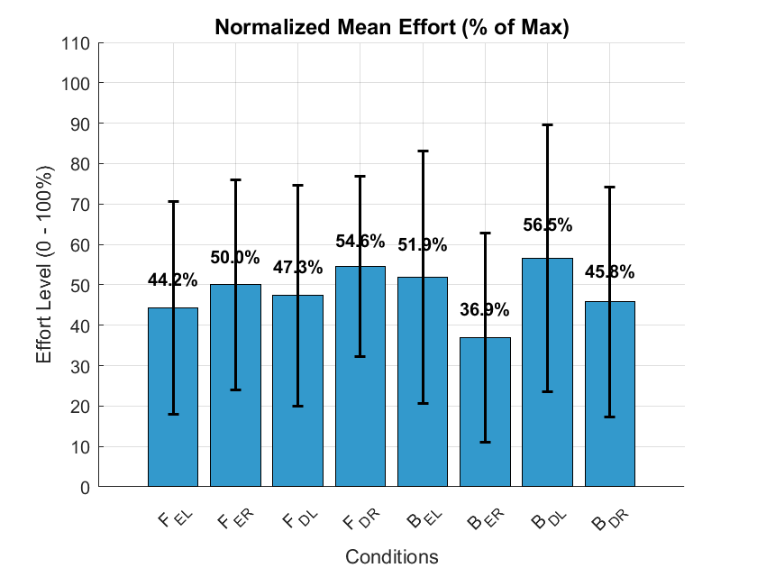
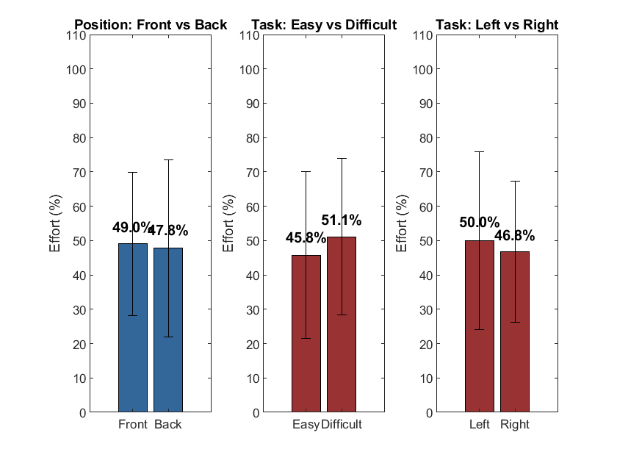
Subjective Analysis - Effort
Figure 12. Subjective Analysis of Percentage Effort[32]
14

Slide 16
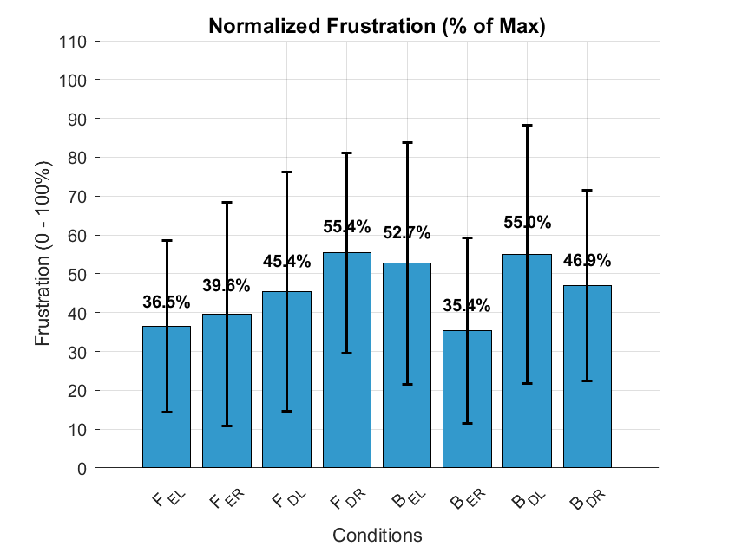

Subjective Analysis - Frustration
Figure 13. Subjective Analysis of Frustration[32]
15

Slide 17
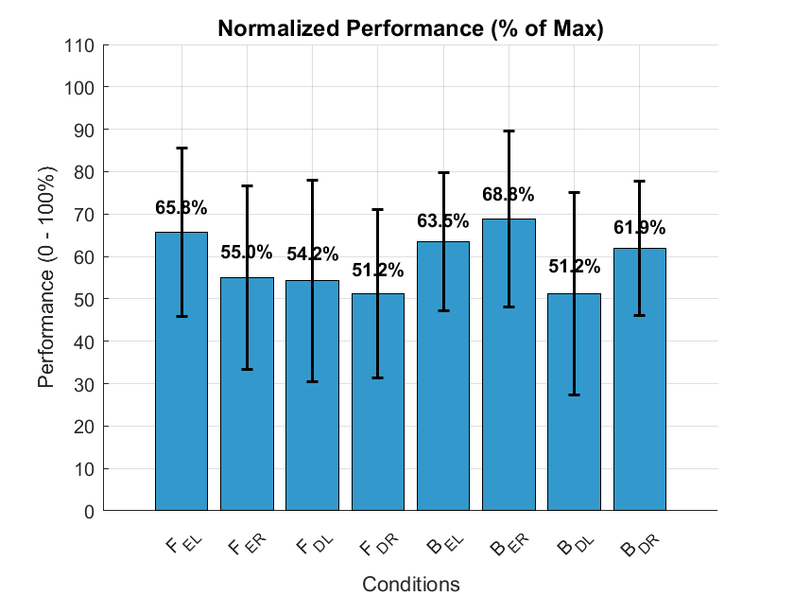
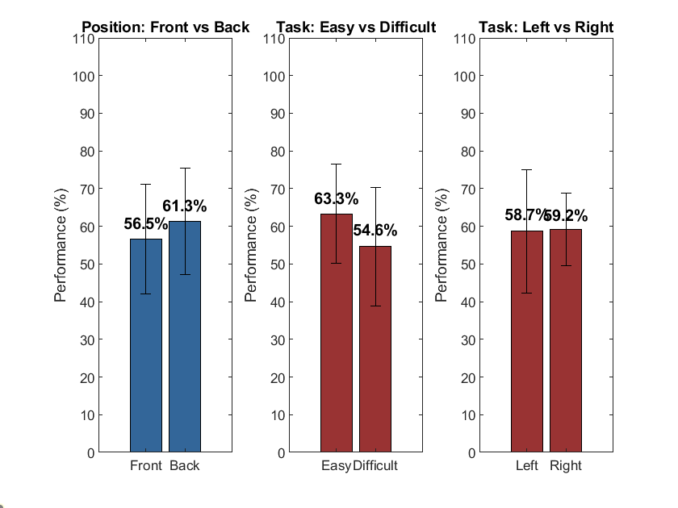
Subjective Analysis - Performance
Figure 14. Subjective Analysis of Performance[32]
16

Slide 18
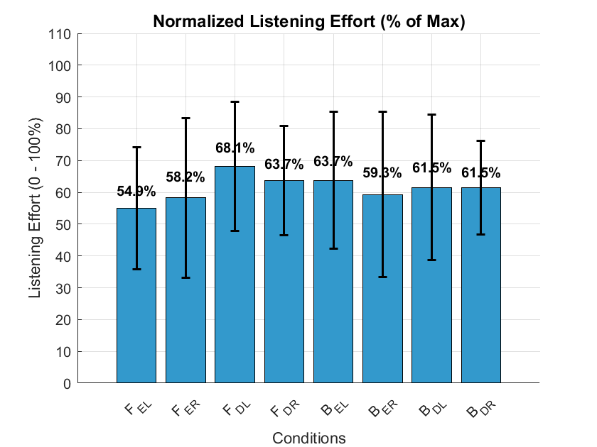
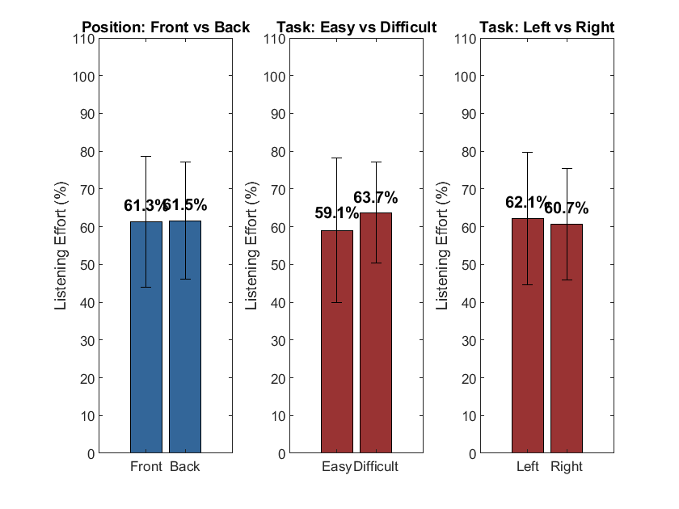
Subjective Analysis - Listening Effort
Figure 15. Subjective Analysis of Listening Effort[32]
17

Slide 19
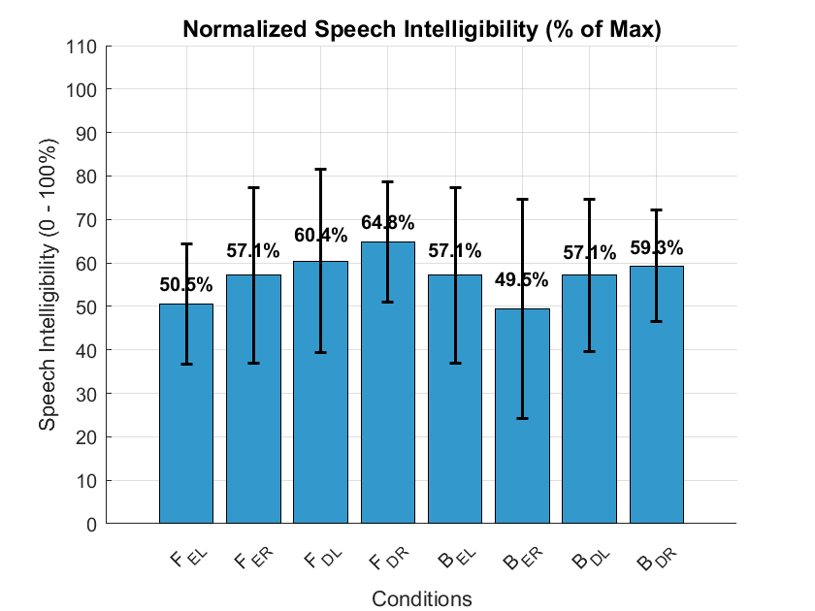
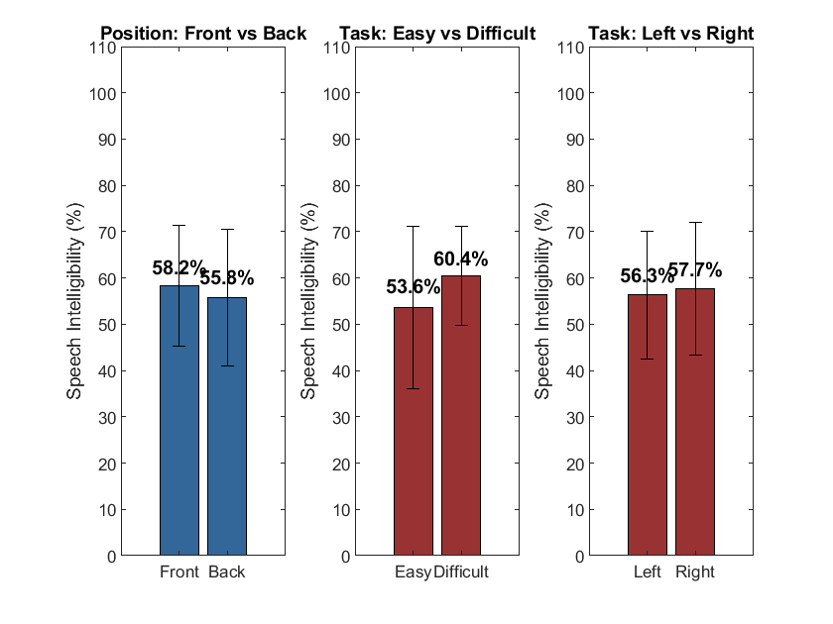
Subjective Analysis – Speech Intelligibility
Figure 16. Subjective Analysis of Speech Intelligibility[32]
18

Slide 20
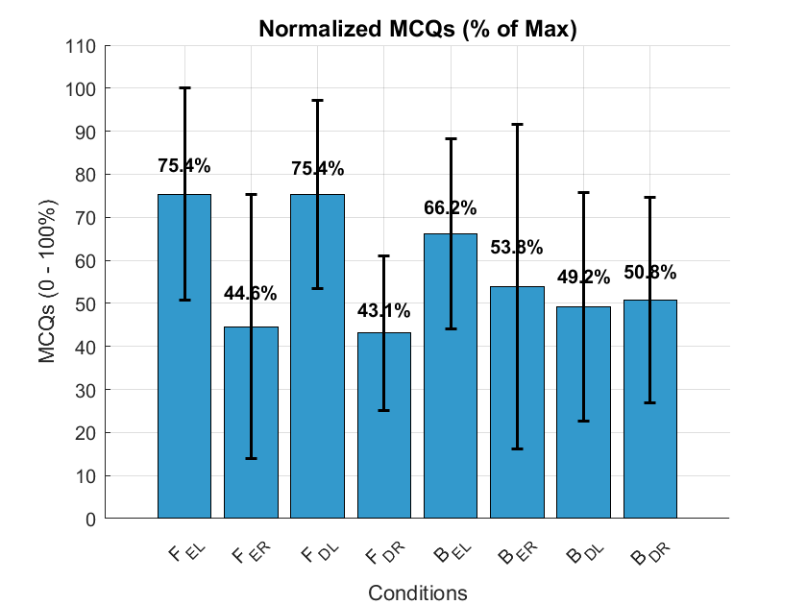
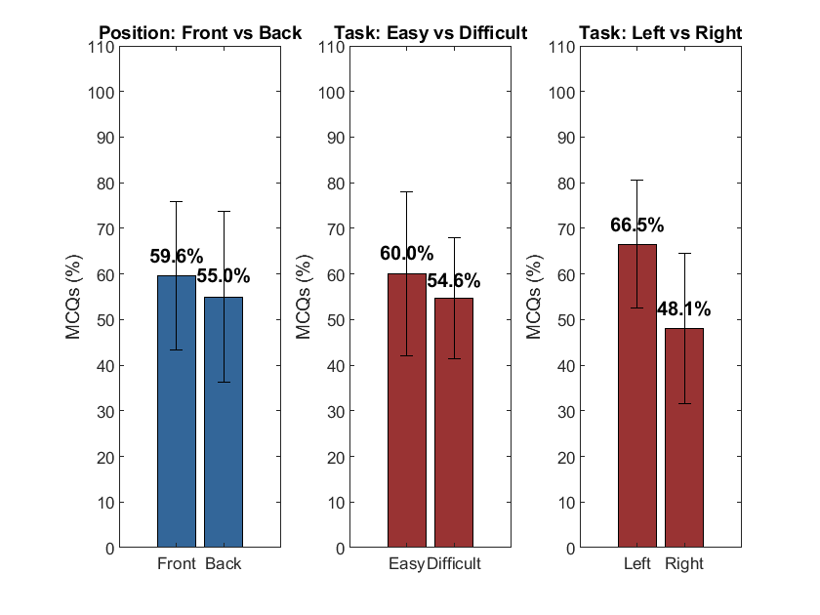
Subjective Analysis – MCQ’s
Figure 17. Subjective Analysis of MCQ’s[32]
19

Slide 21
Objective Analysis - PAM
Source | F-value | p-value | Effect Size (η2) | Interpretation
Position | 30.67 | < .001 | 0.367 | Strong Main Effect
Difficulty | 5.497 | .037 | 0.023 | Significant Main Effect
Lat * Diff | 7.522 | .018 | 0.018 | Significant Interaction
Simple Main Effects - Difficulty
Level of Laterality | Sum of Squares | df | Mean Square | F | p
Ipsi | 6.363×10⁻⁴ | 1 | 6.363×10⁻⁴ | 0.031 | .864
Contra | 0.206 | 1 | 0.206 | 9.866 | .009
Note. Type III Sum of Squares
Table 1. Repeated Measures Annova Table of PAM[29]
20

Slide 22
Objective Analysis - PAM
Post Hoc Comparisons - Laterality ✻ Difficulty
 |  |  | 95% CI for Mean Difference |  |  |  |  |  | 95% CI for Cohen's d
 |  | Mean Difference | Lower | Upper | SE | df | t | Cohen's d | Lower | Upper | p_{Holm}
Ipsi, Easy | Contra, Easy | 0.053 | -0.089 | 0.194 | 0.045 | 12 | 1.179 | 0.236 | -0.413 | 0.886 | .668
 | Ipsi, Difficult | -0.007 | -0.134 | 0.120 | 0.040 | 12 | -0.173 | -0.031 | -0.599 | 0.537 | .865
 | Contra, Difficult | -0.073 | -0.229 | 0.083 | 0.050 | 12 | -1.472 | -0.325 | -1.053 | 0.403 | .668
Contra, Easy | Ipsi, Difficult | -0.060 | -0.191 | 0.071 | 0.042 | 12 | -1.439 | -0.267 | -0.878 | 0.343 | .668
 | Contra, Difficult | -0.126 | -0.221 | -0.030 | 0.030 | 12 | -4.156 | -0.562 | -1.120 | -0.003 | .008
Ipsi, Difficult | Contra, Difficult | -0.066 | -0.188 | 0.056 | 0.039 | 12 | -1.698 | -0.294 | -0.872 | 0.284 | .577
Note. P-value and confidence intervals adjusted for comparing a family of 6 estimates (confidence intervals corrected using the Bonferroni method).
Note. Results are averaged over the levels of: Position
Table 2. Post Hoc Comparison of Laterality vs Difficulty[29]
21

Slide 23
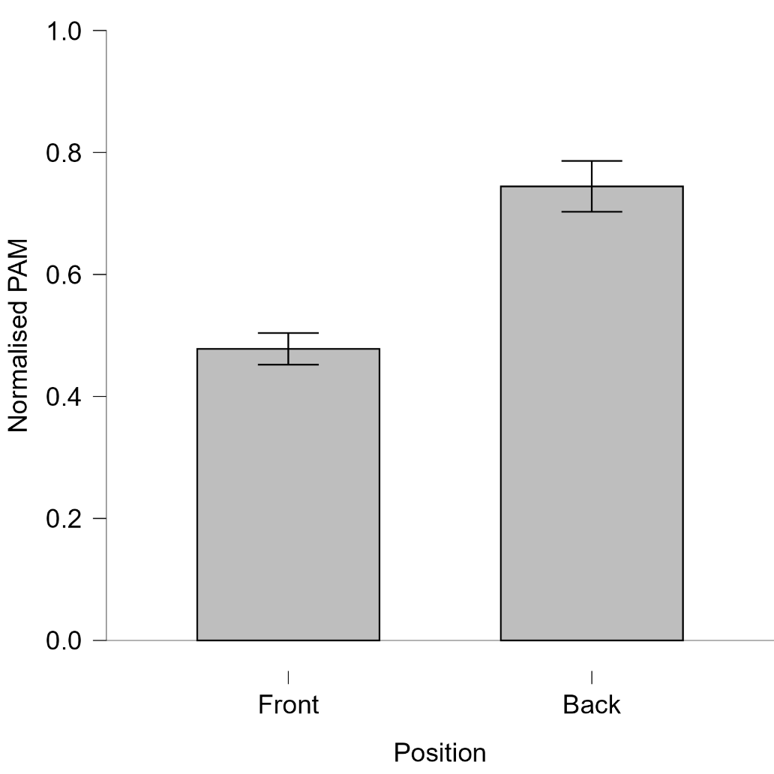
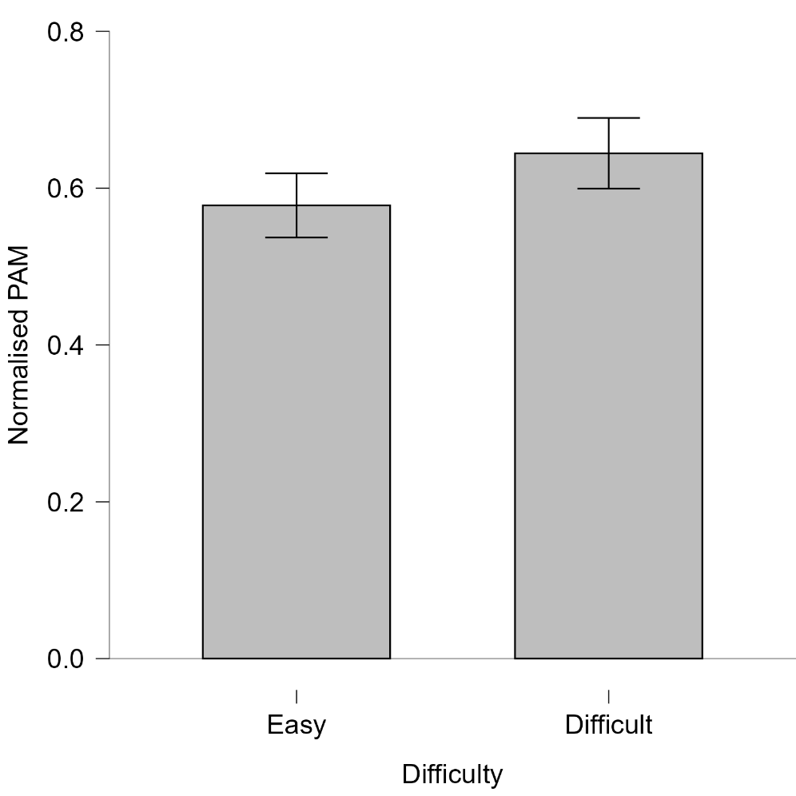
Objective Analysis - PAM
PAM position is significant at *p<0.001
PAM Difficulty is significant at *p<0.037
Figure 18. Bar Plot of Position *p < 0.001 and Difficulty *P < 0.037[29]
*Significant at p < 0.05
22

Slide 24
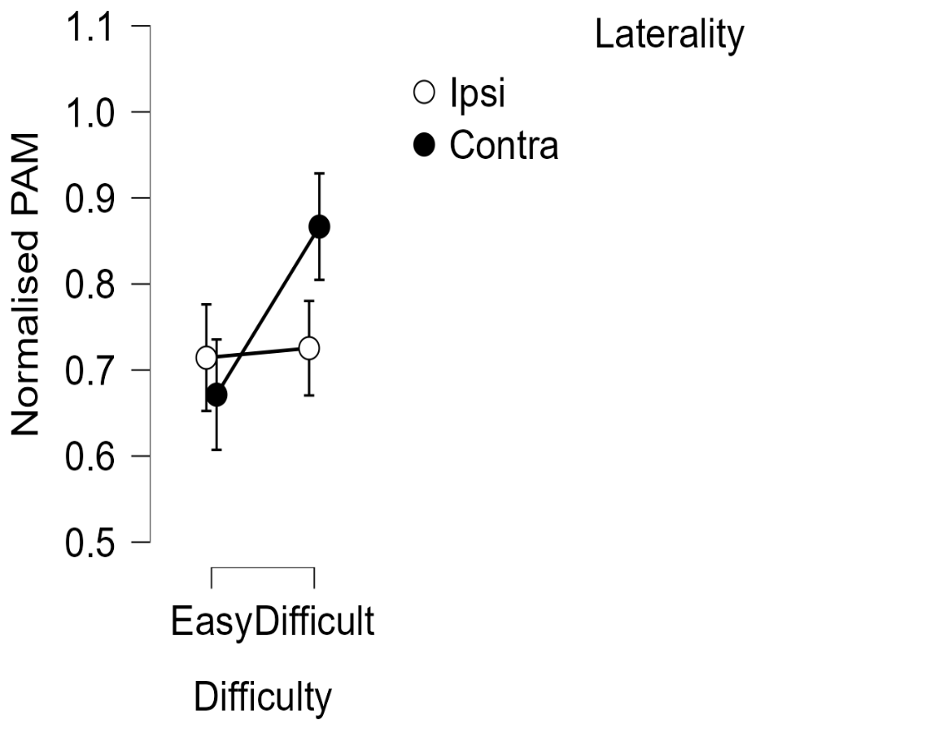
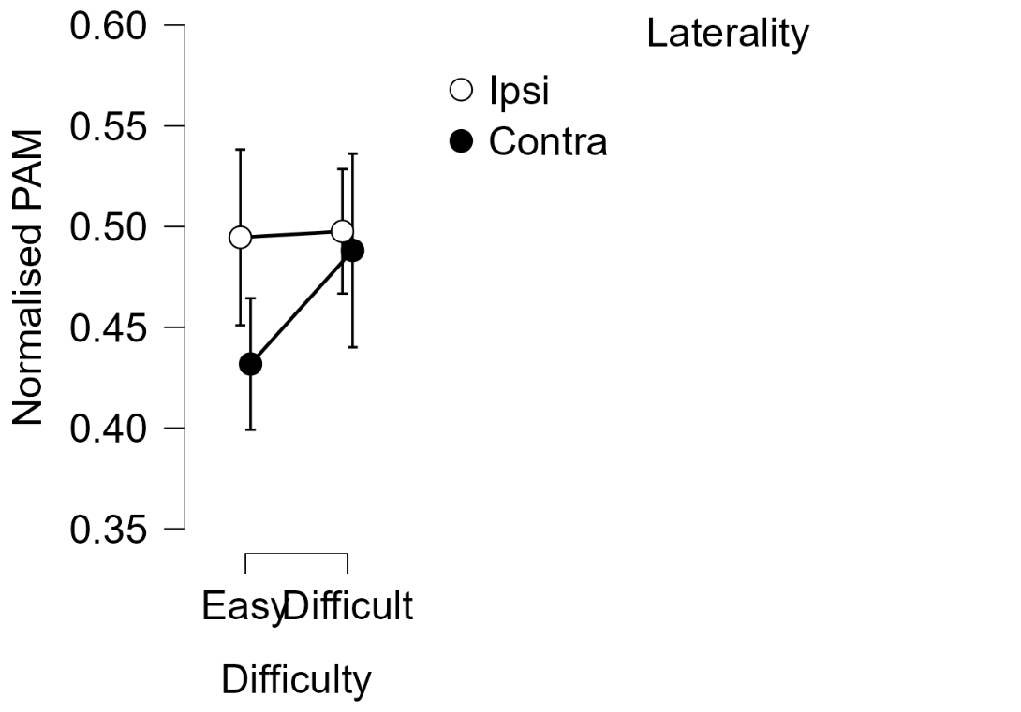
Objective Analysis - PAM
Back vs Laterality vs Difficulty
Front vs Laterality vs Difficulty
Figure 19. Descriptive Plot of Three-way Interaction at Lat vs Diff Significant at *p < 0.018[29]
*Significant at p < 0.05
23

Slide 25
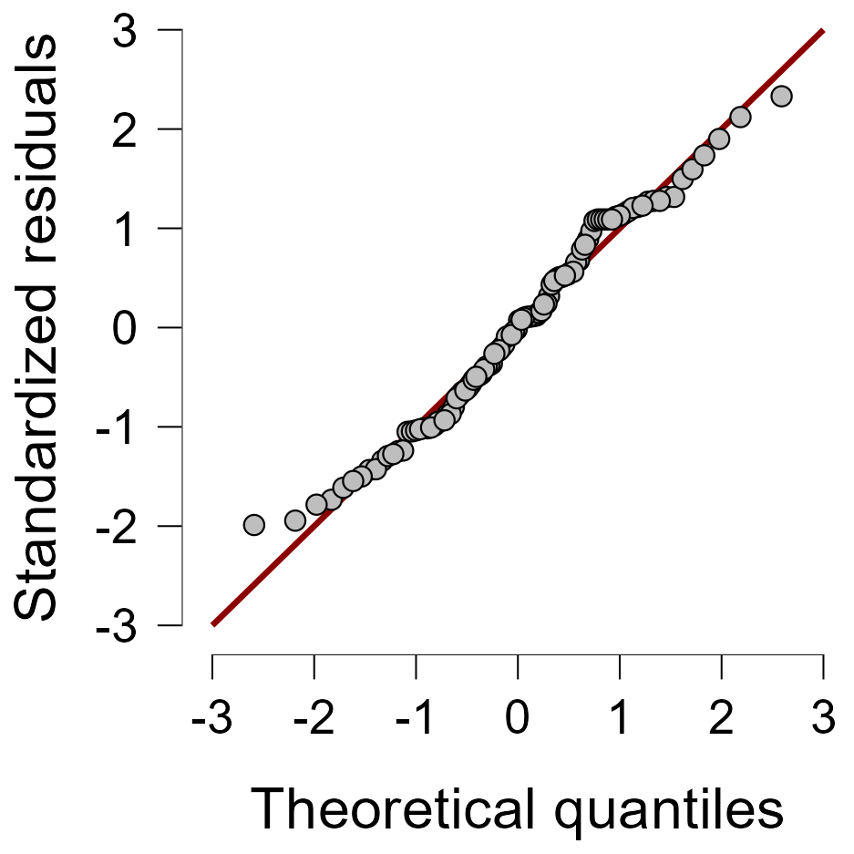
Objective Analysis - PAM
Figure 20. Q-Q Plot of PAM[29].
24

Slide 26
Objective Analysis – PAM, SAM, AAM
Effect | PAM | SAM | AAM
Laterality | .860 | .875 | .051
Difficulty | .037* | .928 | .322
Position | <.001* | .460 | .053
Lat × Diff | .018* | .385 | .091
Lat × Pos | .314 | .284 | .420
Diff × Pos | .344 | .154 | .425
Lat × Diff × Pos | .379 | .776 | .294
Table 3. Comparison of Repeated Measures Annova table of PAM , SAM and AAM[29]
*Significant at p < .05
25

Slide 27
Discussion
Kahneman (System 1/2): Defines the effort level (Automatic vs. Effortful)[11].
Lavie (Load Theory): Explains how capacity is exhausted[10].
Wickens (MRT): Explains why some muscles (SAM/AAM) are sacrificed to save resources[27].
Cowan (Focus of Attention): Pinpoints what the PAM is actually doing. It is the physical "anchor" for the focus of attention[26].
Strauss (Neural Fossil): Confirms that this "anchor" is a permanent evolutionary remnant[1].
26

Slide 28
Discussion
Feature | Strauss et al. (2020) | Your Study
Primary Muscle | PAM (Active) | PAM (Significant modulation)
Secondary Muscles | SAM/AAM (Active) | SAM/AAM (Non-significant/Null)
Cognitive Load | Standard endogenous task | High cognitive load introduced
Conclusion | Supports vestigial orienting | Supports PAM as primary effort-biomarker
Table 4. Comparison of Endogenous experiment result
27

Slide 29
Conclusion
PAM as a Biomarker: We successfully identified the PAM as a reliable physiological indicator of listening effort, independent of general muscle tension.
Evidence of Gating: Our findings support the theory of "inhibitory gating," where the brain selectively suppresses non-essential motor reflexes under stress to protect its limited cognitive resources.
Future Impact: This research paves the way for objective, muscle-based monitoring of mental effort in real-world environments, such as during the use of hearing aids or communication devices.
28

Slide 30
Bibliography
Daniel J Strauss,Farah I Corona-Strauss,Andreas Schroeer,Philipp Flotho,Ronny Hannemann,Steven A Hackley, “Vestigial auriculomotor activity indicates the direction of auditory attention in humans,” eLife, 2020.
Adrian Mai, Steven A. Hillyard, Daniel J. Strauss and Farah I. Corona-Strauss, “Selective Listening to Unpredictable Sound Sequences Increases Tonic Muscle Activity in the Human Vestigial Auriculomotor System,” eNeuro: Society for Neuroscience, 2025.
Katrin Repkow,Stefanie Bauer, “Kenhub,” Kenhub GmnH, 11 October 2023. [Online]. Available: https://www.kenhub.com/de/library/anatomie/musculus-auricularis-posterior.
Schroeer A, Corona-Strauss FI, Hannemann R, Hackley SA and Strauss DJ, “Electromyographic correlates of effortful listening in the vestigial auriculomotor system,” frontiers in Neuroscience, 2025.
P. JE, “Listening Effort: How the Cognitive Consequences of Acoustic Challenge Are Reflected in Brain and Behavior.,” Ear and Hearing, vol. 39, no. 2, p. 204, 2018.
J. Blauert, The Psychophysics of Human Sound Localization, Harvard MA: The MIT Press, 1983.
Pickles, James, An Introduction to the Physiology of Hearing: Fourth Edition, BRILL ACADEMIC PUB, 2013.
Stamatina Kalafata, Kerstin Persson Waye, “THE SAHLGRENSKA ACADEMY INSTITUTE OF MEDICINE THE IMPORTANCE OF LOW FREQUENCY MASKING ON AUDITORY PERCEPTION Literature Review REPORT NO 4:2017 FROM THE UNIT FOR OCCUPATIONAL & ENVIRONMENTAL MEDICINE IN GOTHENBURG,” Arbets- och miljömedicin, Göteborgs universitet, Gothenburg (Göteborg), Sweden, 2020.

Slide 31
Bibliography
R V Shannon 1, F G Zeng, V Kamath, J Wygonski, M Ekelid, “Speech recognition with primarily temporal cues,” Science, vol. 270, no. 5234, p. 303–304, 1995.
Lavie N, Hirst A, de Fockert JW, Viding E., “Load theory of selective attention and cognitive control,” journal of Experimental Psychology, 2004.
Bruya B, Tang Y-Y, “Is Attention Really Effort? Revisiting Daniel Kahneman’s Influential 1973 Book Attention and Effort.,” frontiers in Psychology, 2018.
J. Sweller, “Cognitive load during problem solving: Effects on learning,,” Cognitive Science, vol. 12, no. 2, pp. 257-285, 1988.
B. A, “Working memory: looking back and looking forward.,” Nature Reviews Neuroscience., 2003.
O'Sullivan, J. A., et al,Alan J Power,Nima Mesgarani, Siddharth Rajaram , John J Foxe , Barbara G Shinn-Cunningham , Malcolm Slaney , Shihab A Shamma , Edmund C Lalor, “Attentional Selection in a Cocktail Party Environment Can Be Decoded from Single-Trial EEG. Cerebral Cortex.,” Cerebral Cortex, 2015.
Zekveld AA, Kramer SE, Festen JM, “Pupil response as an indication of effortful listening: the influence of sentence intelligibility.,” Experimental Psychology: Human Perception and Performance., 2010.
Shannon RV, Zeng FG, Kamath V, Wygonski J, Ekelid M, “Speech recognition with primarily temporal cues.,” Science, 1995

Slide 32
Bibliography
M Kathleen Pichora-Fuller 1, Sophia E Kramer, Mark A Eckert, Brent Edwards, Benjamin W Y Hornsby, Larry E Humes, Ulrike Lemke, Thomas Lunner, Mohan Matthen, Carol L Mackersie, Graham Naylor, Natalie A Phillips, Michael Richter, Mary Rudner, “Hearing Impairment and Cognitive Energy: The Framework for Understanding Effortful Listening (FUEL),” Ear and Hearing, 2016.
Pichora-Fuller MK, Kramer SE, Eckert MA, Edwards B, Hornsby BW, Humes LE, Lemke U, Lunner T, Matthen M, Mackersie CL, Naylor G, Phillips NA, Richter M, Rudner M, Sommers MS, Tremblay KL, Wingfield A., “Hearing Impairment and Cognitive Energy: The Framework for Understanding Effortful Listening (FUEL).,” Ear and Hearing, 2016.
Shrestha B, Dunn L., “The Declaration of Helsinki on Medical Research involving Human Subjects: A Review of Seventh Revision,” Journal of Nepal Health Research Council., 2020.
A. Budge, “English Learning for Curious Minds,” [Online]. Available: https://www.leonardoenglish.com/podcasts.
Manyaa Bhatia, Samantha O’Connell, Julianne M Papadopoulos, Raymond L Goldsworthy, “Implementation of Cochlear Implant Speech Processor Architecture in MATLAB,” Bridge UnderGrad Science (BUGS) Summer Research Program.
“Cochlear Implant Speech Processor,” Mathworks, 2005-2022. [Online]. Available: https://de.mathworks.com/help/dsp/ug/cochlear-implant-speech-processor.html.
Angel de la Torre Vega ,Marta Bastarrica Mart,Rafael de la Torre Vega,Manuel Sainz Quevedo, “Cochlear Implant Simulation version 2.0,” University of Granda , 2004.

Slide 33
Bibliography
Urban PP, Marczynski U, Hopf HC, “The oculo-auricular phenomenon. Findings in normals and patients with brainstem lesions.,” Brain, 1993.
Hillyard SA, Hink RF, Schwent VL, Picton TW, “Electrical signs of selective attention in the human brain,” Science, 1973.
N. Cowan, “An Embedded-Processes Model of working memory,” APA PsycNet, 1997.
Wickens, C. D, “Multiple Resources and Mental Workload.,” Human Factors, vol. 50, no. 3, pp. 449-455, 2008.
M. GA., “Comparative Auditory Neuroscience: Understanding the Evolution and Function of Ears.,” Journal of the Association for Research in Otolaryngology, p. 1, 2016.
JASP Team, "JASP (Version 0.19.0)," JASP Team, 2026. [Windows 11].
PreSonus Audio Electronics, "Studio One (Version X.X)," PreSonus Audio Electronics, Baton Rouge, LA, USA, 2026. [Windows].
diagrams.net, "diagrams.net (Version 26.0.0)," JGraph Ltd, 2026. [Windows 11].
The MathWorks Inc., "MATLAB (Version 2023b)," The MathWorks Inc., Natick, MA, USA, 2023. [Windows 11].

Slide 34
Thank You For Your
(Endogenous) Attention

